Slide 1
CUSTOMER RELATIONSHIP MANAGEMENT
CONCEPTS AND TECHNOLOGIES
Chapter 8
Managing the customer life-cycle:
customer acquisition

Slide 2
Three stages of the customer life cycle
Customer acquisition
Customer development
Customer retention

Slide 3
Key customer acquisition questions
Which prospects (potential new customers) will be targeted?
How will these prospects be approached?
What offer will be made?

Slide 4
Two types of new customer
New-to-category customers
  are customers who have either identified a new need or have found a new category of solution for an existing need.
New-to-company
  are customers are won from competitors.

Slide 5
Portfolio purchasing
Customers buy on a portfolio basis when they buy from a choice set of several more or less equivalent alternatives.
A customer who has not bought from one of the portfolio suppliers for a matter of months or even years, may still regard the unchosen supplier as part of the portfolio.

Slide 6
Strategic switching
Strategic switching occurs when customers who shift their allegiances from one supplier to another in pursuit of a better deal.
Banks know that their promotional pricing stimulates hot money.

Slide 7
Selection of prospects to target for acquisition
What is the estimated value of the customer?
  This depends on the margins earned from the customer’s purchases over a given time period.
If that customer switches from his current supplier/s, what proportion of category spending will your company earn?
What is the probability that the customer will switch from current supplier/s?

Slide 8
Hofmeyr’s conversion model
Hofmeyr’s basic premise is that customers who are not committed are more likely to be available to switch to another provider.
Commitment is a function of satisfaction with the brand or offer, the attractiveness of alternatives, and involvement in the brand or offer.

Slide 9
Profiling committed and uncommitted customers
Committed customers
  Entrenched customers are unlikely to switch in the foreseeable future
  Average customers are unlikely to change in the short term but may switch in the medium term
Uncommitted customers
  Shallow customers have a lower commitment than average, and some of them are already considering alternatives
  Convertible customers are most likely to defect

Slide 10
Four questions to assess commitment
How happy are you with <whatever it is>?
Is this relationship something that you care about?
Is there any other <whatever it is> that appeals to you?
If so, how different is the one <whatever> from the other?

Slide 11
Profiling non-customers
Open non-customers
  Available non-customers prefer the alternative to their current offer though they have not yet switched, and are ready to switch.
  Ambivalent non-customers are as attracted to the alternative as they are to their current brand
Unavailable non-customers
  Weakly unavailable non-customers prefer their current brands
  Strongly unavailable non-customers have a strong preference for their current brands

Slide 12
B2B prospecting: key questions
Does the lead have a need for my company’s products?
Does the lead have the ability to pay?
Is the lead authorised to buy?

Slide 13
Sources of B2B leads
Satisfied customers
  Referrals from satisfied customers
Networking
  Personal contacts with well-connected and co-operative people
Promotional activities
  Exhibitions, seminars, tradeshows and conferences
    Delegate and attendee lists
  Advertising response inquiries
  Publicity
Web-sites
Lists and directories
  SIC listings, telephone directories
Canvassing
Tele-marketing
E-mail

Slide 14
Networking definition
Networking is the process of establishing and maintaining business-related personal relationships

Slide 15
Publicity definition
Publicity is the generation of free editorial content relevant to a company’s interests

Slide 16
How do customers search online?
Keying in a page’s URL
Using search engines
Exploring directories, web catalogues or portals
Surfing

Slide 17
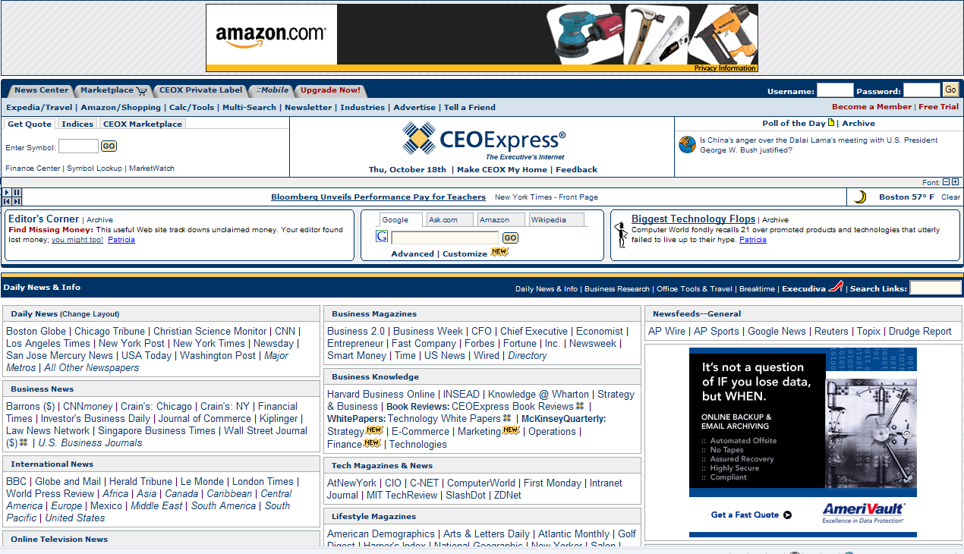
The portal CEOExpress

Slide 18
Sources of B2C prospects
advertising
sales promotion
buzz or word-of-mouth
merchandising

Slide 19
Advertising definition
Advertising is the creation and delivery of messages to targeted audiences through the purchase of time or space in media owned by others.

Slide 20
Cognitive and affective advertising objectives
Cognitive advertising objectives include: raising awareness, developing understanding, and generating knowledge. New customers generally need to be made aware of the product and to understand what benefits it can deliver
Affective advertising objectives include developing a liking for the product, and generating preference

Slide 21
Advertising questions for customer acquisition
Which messages will generate most new customers?
Which media are most cost-effective at customer acquisition?

Slide 22
Cut-through
An advertisement must stand out from the background clutter and claim the audience’s attention. Advertisers call this ‘cut-through’.
Standing out is a matter both of message creativity and execution, and media selection.
What stands out?
  black and white ads in colour magazines
  image-based ads in text-dominated media
  loud ads in quiet media
  ads that leave you wondering ‘what was that all about?’
  ads that challenge your comprehension and emotions.

Slide 23
Execution styles
Slice-of-life
  product being used in a recognisable context
Aspirational
  associates the product with a desirable outcome or life-style
Testimonial
  the product is endorsed by an opinion-influencer
Comparative
  the ad compares one or more alternatives with the advertised product

Slide 24
Pre-testing ads
Recall. How much of the ad can the sample recall?
Comprehension. Does the sample understand the ad.?
Credibility. Is the message believable?
Feelings evoked. How does the sample feel about the ad?
Intention-to-buy. How likely is it that the sample will buy?

Slide 25
Reach and frequency definitions
Reach is the total number of a targeted audience that is exposed at least once to a particular ad or campaign
Frequency is the average number of times that a targeted audience member is exposed to an ad or campaign

Slide 26
Media efficiency statistics
Response rates provide a first-level indicator of ad effectiveness.
  Examples include the number of coupons clipped and returned, or calls requesting information (RFI) made to a contact centre.
Conversion rates offer a second-level indicator of ad effectiveness.
  Examples include sales made as a percentage of coupons returned, or proposals submitted as a percentage of RFIs.

Slide 27
Sales promotion definition
Sales promotion is any behaviour-triggering temporary incentive aimed at prospects, customers, channel partners or salespeople

Slide 28
Types of consumer sales promotion
Sampling
Free trials
Discounts
Coupons
Rebates or cash-back
Bonus packs
Banded packs
Free premiums
Cross promotions
Lotteries
Competitions

Slide 29
Buzz or word-of-mouth definition
Word-of-mouth is interpersonal communication about a product or organization in which the receiver assumes the communicator to independent of commercial influence.

Slide 30
Merchandising definition
Merchandising is any behaviour-triggering stimulus or pattern of stimuli, other than personal selling, that takes place at retail or other points-of-sale

Slide 31
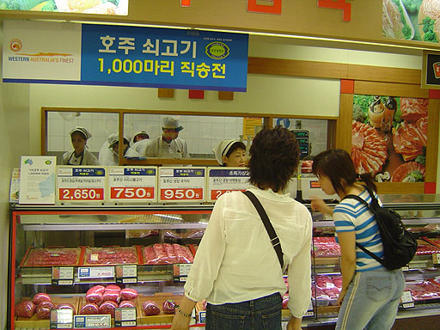
Western Australian meat is merchandised in Korea

Slide 32
Referral schemes
Customer Referral Schemes (CRS) are also known as Member-Get-Member (MGM) and Recommend-A- Friend (RAF) schemes.
These work by inviting existing customers to recommend a friend and rewarding the recommender with a gift.
Need to choose the right customer and the right time to invite a referral.
Schemes are more effective when targeted at a relevant section of the customer base, e.g. customers who are satisfied or customers who have just experienced excellent service.

Slide 33
KPI’s for customer acquisition programs
How many customers are acquired?
What is the cost per acquired customer
What is the value of the acquired customer?

Slide 34
Making the right offer
Some industries are consistent in their use of entry-level products for customer acquisition.
  Insurance companies use automobile insurance to acquire new customers.
  Banks use relatively high interest rates on deposit account, or relatively low charges on credit cards.
  Supermarkets price high demand, frequently purchased items such as bread as loss leaders in order to build store traffic.

Slide 35
Operational CRM tools that help customer acquisition
lead management
  The lead management process includes a number of sub-processes, including lead generation, lead qualification, lead allocation and lead tracking
campaign management
  Campaign managers design, execute and measure marketing campaigns with the support of CRM technologies. Sometimes these are multi-media campaigns across direct mail, email, fax, outbound telephony, and SMS platforms
event-based marketing
  EBM provides companies with opportunities to approach prospects at times which have a higher probability of leading to a sale, e.g. important life-stage events

Slide 36
CRM analytics supports customer acquisition
Operational CRM tools have to be supported by sound analytics to ensure that the right offer is made to the right prospect through the right channel at the right time.
It is often possible to query current customer-related databases for clues to guide customer acquisition.

